Slide 1
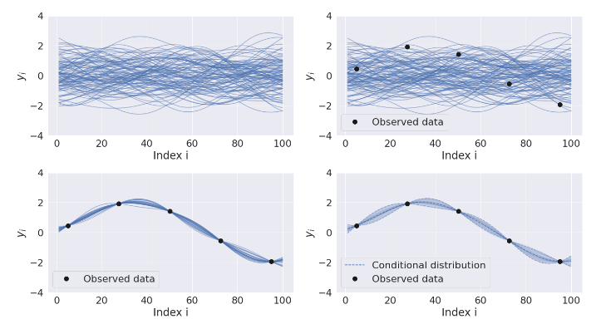




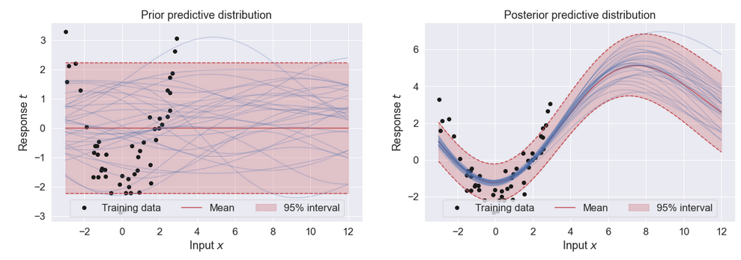


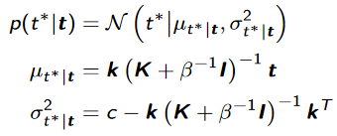
Gaussian Process
Classic Regression
Bayesian Regression
Gaussian Process
New model:
Prior and Likelihood:
Predictive:

Slide 2

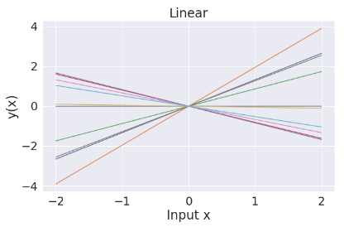
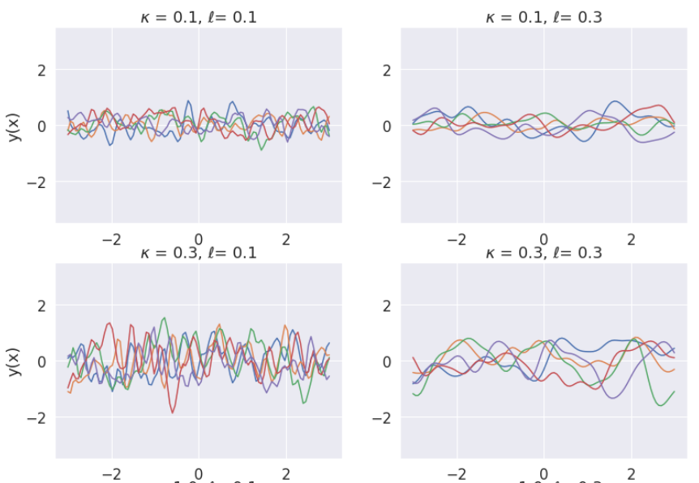
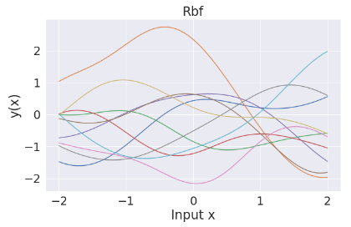
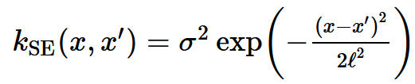
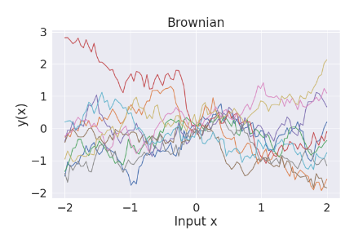
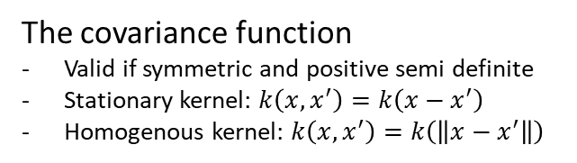
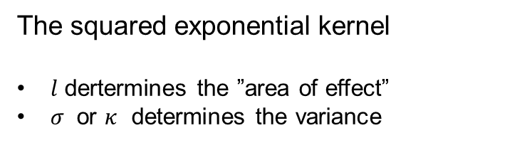
The Covariance Function
The squared exponential kernel
$l$ dertermines the ”area of effect”
$σ$ or $κ$ determines the variance
Behavior fully described by mean- and covariance-function
The covariance function
Valid if symmetric and positive semi definite
Stationary kernel: $k\left(x,x^{′}\right)=k\left(x−x^{′}\right)$
Homogenous kernel: $k\left(x,x^{′}\right)=k\left(\left\|x−x^{′}\right\|\right)$

Slide 3
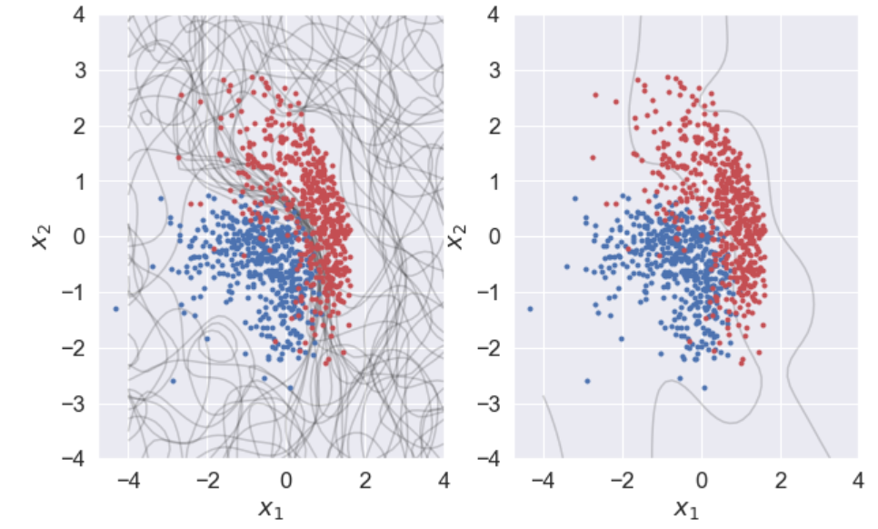
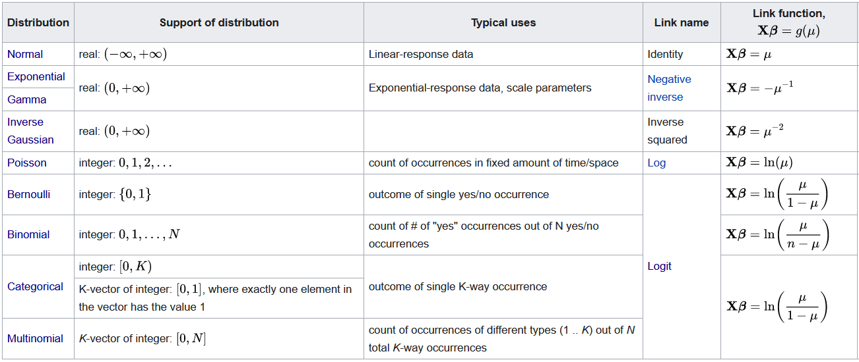
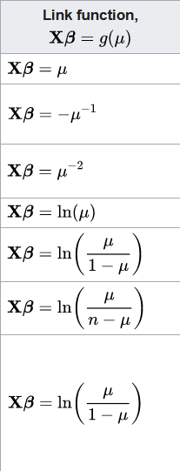
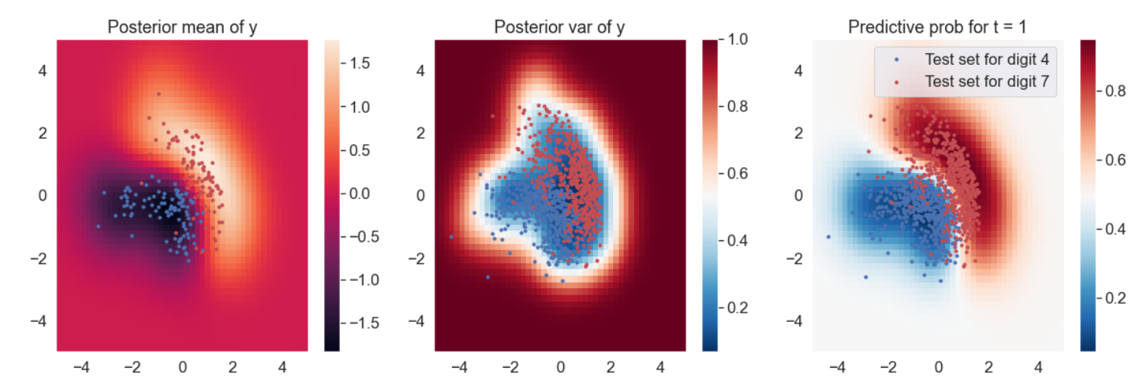

Generalized Linear Model

